Slide 1
Coding guidelines, Testing
Ramaswamy Krishnan Chittur

Slide 2
Coding standards
Coding conventions - naming, formatting, spacing:
Framework Design Guidelines | Microsoft Learn
C# Coding Conventions | Microsoft Learn
Common C# Coding Conventions | Microsoft Learn
Naming Guidelines - Framework Design Guidelines | Microsoft Learn
Use the Visual Studio editor:
EditorConfig settings - Visual Studio (Windows) | Microsoft Learn
Static code analysis tools:
Code analyzers for .NET Framework | Microsoft Learn
Code analysis in .NET | Microsoft Learn
.NET Analyzers · GitHub
Additional checks:
Comments, XML documentation.
Cyclomatic complexity, lines of code in a function.
Debug.Assert, Trace Logging.

Slide 3
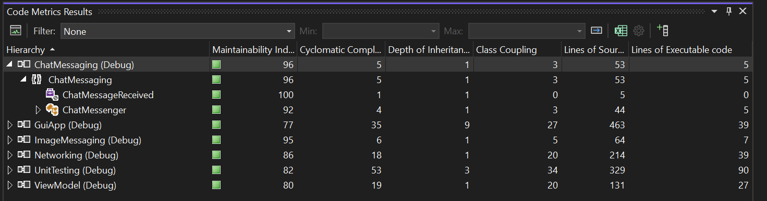
Code metrics
Provides developers better insight into the code they are developing.
Developers can understand which types and/or methods should be reworked or more thoroughly tested.
Can identify potential risks, understand the current state of a project, and track progress during software development.
-
Reference: https://learn.microsoft.com/en-us/visualstudio/code-quality/code-metrics-values?view=vs-2022

Slide 4
Testing
Types of tests:
Unit tests
Integration tests
End-to-End tests
Stress tests
Reference: https://learn.microsoft.com/en-us/dotnet/core/testing/

Slide 5
Mock-object testing
Substitute and simulate objects that the component in test deals with.
This is typically done to enable testing various scenarios.
See: moq/moq: The most popular and friendly mocking framework for .NET (github.com) for one such framework.

Slide 6
Testing focus
Use bread toaster as an example:
Functionality
Error
Performance
Globalization
Security
User experience
Stress / durability / reliability
Portability
Localization
Smoke
Boundary
Cost / resources
Maintenance [lines of code in a function, componentization, cyclomatic complexity]

Slide 7
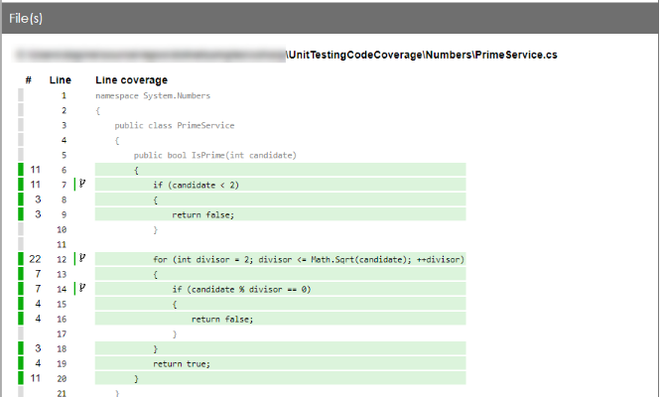
Code coverage
Code coverage is a measurement of the amount of code that is run by unit tests - either lines, branches, or methods.
Options:
Visual Studio in-built code coverage
Use code coverage for unit testing - .NET | Microsoft Learn
FineCodeCoverage/README.md at master · FortuneN/FineCodeCoverage · GitHub
-

Slide 8
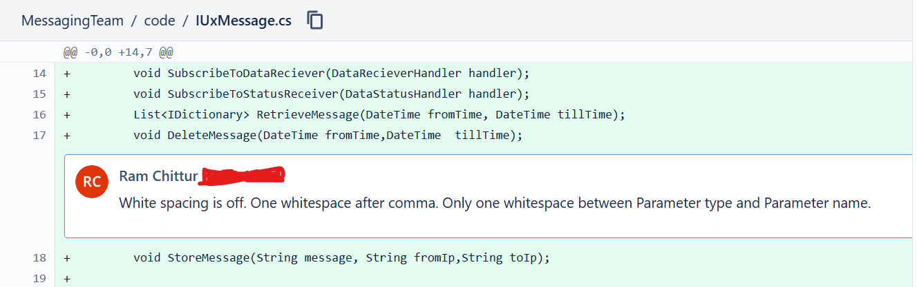
Code review
Peers read and review the code before check in.
Reference:
What are Code Reviews, Why Should We Spend Time on Them, and How Can We Improve Them? (davidgiard.com)
C# Code Reviews - Code With Engineering Playbook (microsoft.github.io)
Improve Code Quality with Code Reviews | Microsoft Learn
-

Slide 9
Exercise
Please refer to the .editorconfig file in this project: chittur/distributed-and-gui-demo: Demonstrates a distributed computing software that also involves GUI (github.com). Please try using it (with any required updates and modifications) in your code projects.

